Slide 1

Wine Quality Analysis
Presented By- Neelavo Dutta, Ritam Biswas, Srija Mondal
Subject : Major Project and Viva VOCI
Subject Code: BBARE - 682
Branch: BSc Data Science
Semester: 6th
Associates with
IAER

Slide 2
INTRODUCTION
This project focuses on performing a comprehensive exploratory data analysis (EDA) of the Wine Quality Dataset using Python. The goal is to understand the factors that influence wine quality, visualize the distribution of chemical attributes, compute central tendencies, and derive key insights. This analysis can serve as a foundation for building predictive models and informing quality control processes in wine production.

Slide 3


TOOLS and Technologies Used
Programming Language: Python
Libraries:
pandas: for data manipulation
numpy: for numerical operations
matplotlib and seaborn: for data visualization

Slide 4
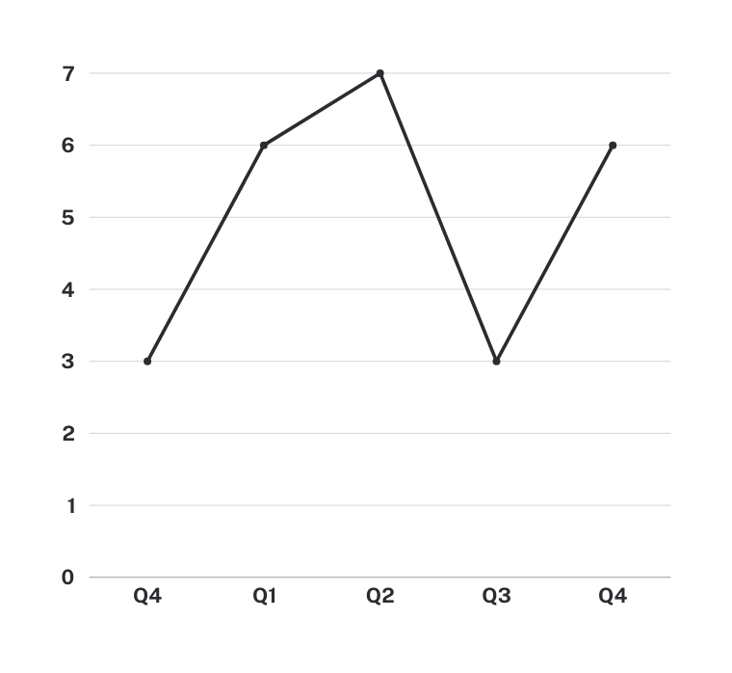
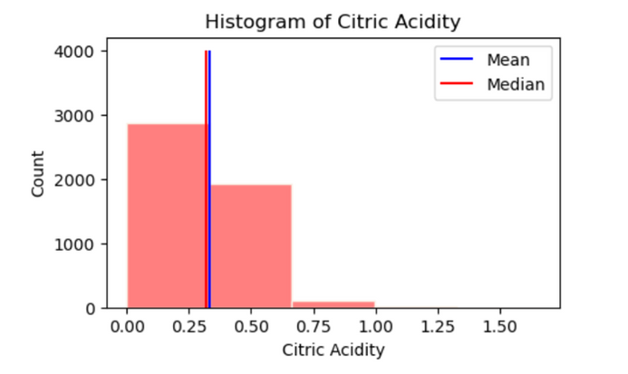
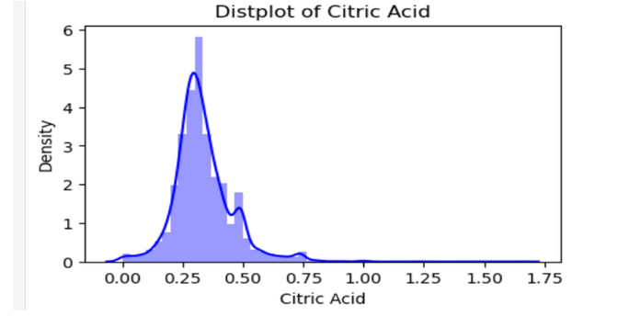
OBSERVATIONS FROM TASK
Task 1- There are 4898 row and 12 colunm in the data. each row contains the details of the types of acids present in white- wine and the quality.
The feature in the data set are: Diffrent acid and their quality.
Task 2 - We saw the distributions of the various features in the data set using appropriate plots
We calculated central tendency measures like mean, median and mode for the various features
The mean and the median for all the above features were similar, so we can choose the mean in these cases
The mode of the "Quality" feature can be chosen as a representative value.

Slide 5
REPRESENTATIVE VALUES
6.8
Fixed Acidity (mean): 6.854
Volatile Acidity (mean): 0.2782
0.27
Citric Acid (mean): 0.3341
0.33

Slide 6
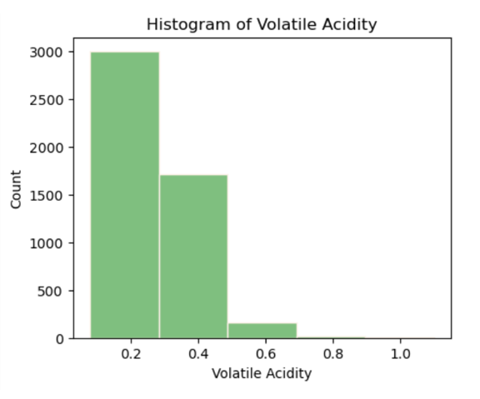
OBSERVATIONS
We observe that this histogram is not well distributed, it is skewed a little towards the right. As we have seen skewness, therefore we can check the distribution using distplot function.

Slide 7
Thank you!
Presented By- Neelavo Dutta, Ritam Biswas, Srija Mondal

